Slide 1


Slide 2
It all started with the Vision of a woman!

Slide 3

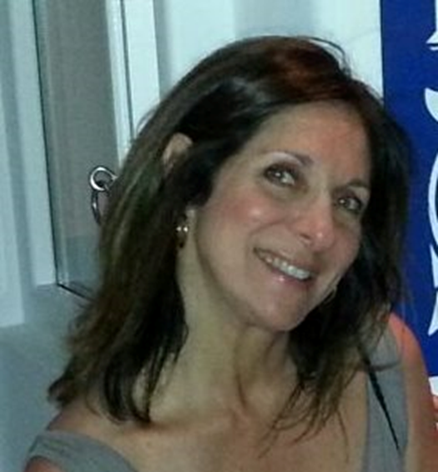
Irene Notias
16 years, 24-7, actively serving the top Greek & American Shipping companies with their Bunker (Marine Fuel) Purchases as a Bunker Broker, Sales & Marketing Manager & Exclusive Purchasing Agent +another 16 years working in Administration posts for NYC high-profile firms

Slide 4
THEN, Shipping met HR …

Slide 5

Efharis Perpinia
An experienced HR Professional with extensive and well rounded experience in Human Resources and Communication.
27 years in the Business, in several industries, across different sectors, both in Greece and Internationally.
Passionate about value-adding HR support and a dedicated advocate of the value of talented people as the number one factor of success in any business endeavor!

Slide 6

….. to sustain excellence & strengthen the shipping industry,
by boosting and upgrading
young professionals-in-the making

Slide 7


Slide 8

Our Mission :
to be a bridge that
connects talented people
to Shipping Companies!

Slide 9


Slide 10

Recruitment
  Internships
  Permanent Appointments
    Entry-level
    Middle-level
    Senior-level
  Sandwich Courses
Courses & Seminars
  Personal Branding
  Build your Success Story in Shipping
  Navigating times of Change
  Leadership Development
  Managing effectively & efficiently
  Skills, Tips & Tricks
Consultation & HR Outsourcing
  Restructuring / Rightsizing
  Update / Redesign of Processes & Procedures
  Recruitment & Human Capital Development
  Design & Implementation of Change processes
  Tailor made HR Outsourcing

Slide 11

Internships
young, talented newcomers
(non-experienced graduates or senior students),
familiarize with “what it means to work in shipping”,
short and agreed period of time (1-6 months),
in top performing Companies
CV presentation free of charge!

Slide 12
Entry-level Jobs
well-educated candidates,
1-3 years of experience,
fill in a temporary or permanent assignment.
a role profile, 3 fitting candidates, short reports
    (including professional competencies and behavioral traits)

Slide 13
Mid-level Jobs
highly qualified professionals
3-7 years of experience
a project or a permanent role
role profile, 3-5 candidates, short reports
(including professional competencies and behavioral traits)

Slide 14
Senior Jobs
Seasoned, high-caliber professionals,
+ 7 years of experience & well-rounded knowledge
for a senior role in the organization.
Specialized search, with state-of-the-art assessment methods, presentation of 3-5 candidates, reports
Joint interviews with the client
feedback and final assessment

Slide 15
Clarity & Transparency
Our fees are fixed and pre-agreed, in writing.
PRIME Customers are entitled to a 10% discount.
Half of the agreed fee on confirmation of the assignment
remaining half upon decision about the selected candidate
6-month guarantee accompanies all our projects. (In case, either the candidate or the company, or mutually agree to end the cooperation, CONNECT will find a replacement at no cost)

Slide 16

Support the success story!
Shipping is of one of the core pillars
of the Greek economy
& a strong gear of the Country’s Turnaround!

Slide 17

Become part of a unique experience and enjoy exceptional benefits!
AMBASSADORS :
promote CONNECT H.E.R
refer or link us to other potential clients within the Shipping Industry!
We do the same for them & promote them in all
our online communication (site, social media)

Slide 18

SUPPORTERS
promote
CONNECT H.E.R. &
offer internships or “sandwich” courses
At the amount of 150€ /year, we promote them as employers and offer one "entry-level" placement
for free!

Slide 19

For a unique menu
of tailor-made benefits
& highly professional HR services, including consultation, employee placements, design & execution of training & development activities, special events organization, etc.

Slide 20

BRONZE (500€/yr+VAT)
1 internship placement per year
Screening of up to 100 CV's versus specific role requirements
One 2-hr seminar for 4-6
  employees or junior managers
  on relevant business topics

Slide 21

SILVER (1.500€/yr+VAT)
2 internship placements per year
Role profile & competencies for one entry or middle level vacancy
Screening of up to 200 CV's versus the specific requirements and presentation of a list of max 20 best applicants
One 3-hr seminar for 4-6 junior
  or Middle managers
  on relevant business topics

Slide 22

GOLD (3.000€/yr+VAT)
2 internships per year
Definition of Role profile & competencies for one middle or senior level vacancy
Screening of up to 200 CV's vs specific requirements and presentation of
  a shortlist of max 20 candidates
Invitation of up-to 10 applicants
  for joint interviews with Company
  Managers and recommendation
  on best choice

Slide 23

DIAMOND (5.000€/yr+VAT)
2 internships per year
One placement of a Senior Executive
1/2day workshop for 6-10 Senior Company Managers on Managerial or Leadership topics.
OR
Design and implementation of a change, restructuring or rightsizing project, explicitly tailor-made to the Company's needs.
  Including needs-assessment analysis, proposal, agreement of deliverable, steps & time
  schedule, process monitoring and
  success metrics!

Slide 24
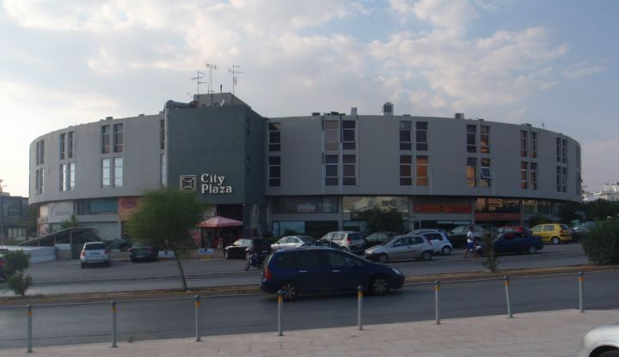
To JOIN us and become PARTNERS, contact us here:
CONNECT H.E.R.
a division of PRIME MANAGEMENT SERVICES
City Plaza, Office # 310
E-mail: bridge@connect-her.gr

Slide 25
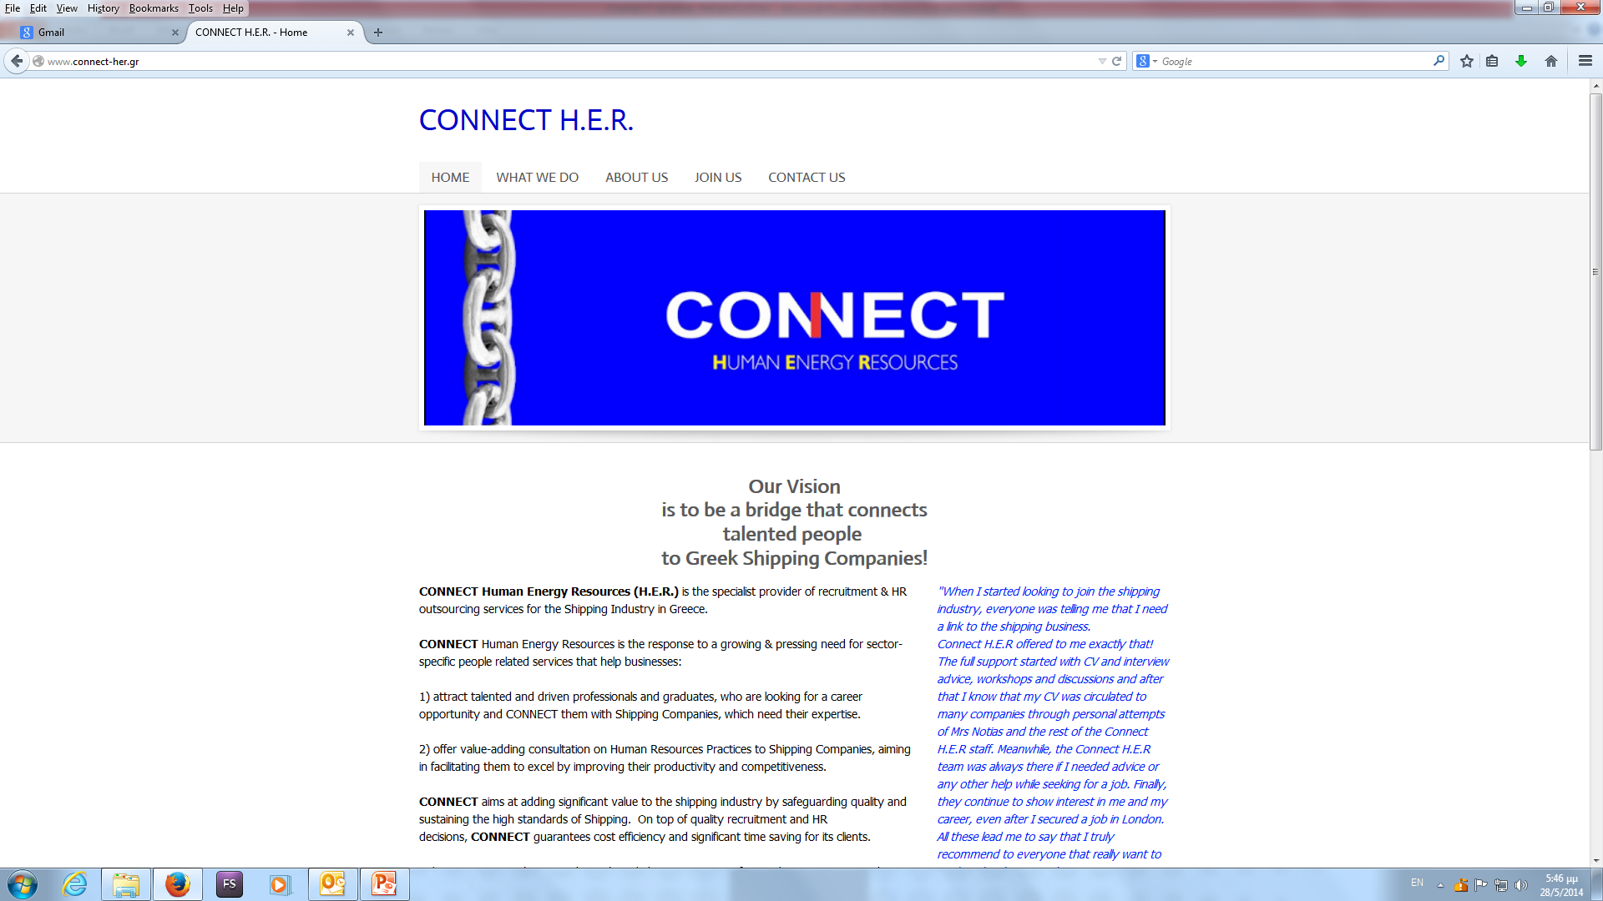
and here …

Slide 26

Our motto…

Slide 27
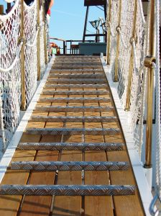
You are
welcome aboard!

